Slide 1
Artificial neural network based Self-taught leaning on text mining
Lecture 14 -
1
Fei-Fei Li & Justin Johnson & Serena Yeung Lecture 14 - May 23, 2017

Slide 2
Contents
Introduction(what is self-taught learning)
Related work
Pre-processing
Segmentation
Feature Extraction
Self-taught learning
OCR Pipeline
Text mining representation
Convolutional Neural Network for text
Datasets
Result
Lecture 14 -
2

Slide 3
Introduction
What is Self-taught Learning?
Self-taught Learning is one kind of Transfer learning
We do not assume:
The unlabeled data follows the same class labels or generative distribution as the labeled data
We will use:
Large number of unlabeled text randomly downloaded from the Internet to improve performance on a given text classification task.
Lecture 14 -
3

Slide 4
Introduction
Overview:
 | Source Data (Not directly related to task)
Target Data |  | Labelled | Unlabeled
 | Labelled | Fine-tuning
 | Unlabeled
Lecture 14 -
4

Slide 5
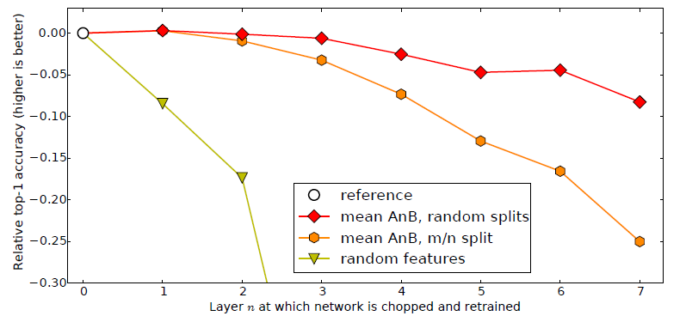
Introduction
Overview: Fine-tuning example
Only train the rest layers
Jason Yosinski,Jeff Clune,Yoshua Bengio,HodLipson, “How transferable are features in deep neural networks?”, NIPS, 2014
Lecture 14 -
5

Slide 6
Introduction
Overview:
 | Source Data (Not directly related to task)
Target Data |  | Labelled | Unlabeled
 | Labelled | Fine-tuning Multitask Learning
 | Unlabeled
Lecture 14 -
6

Slide 7
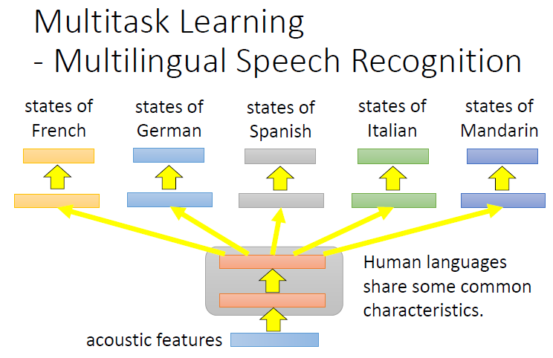
Introduction
Overview: Multi-task Learning
Daxiang Dong, HuaWu, Wei He, Dianhai Yu and Haifeng Wang, “Multi-Task Learning for Multiple Language Translation - ACL Anthology”, ACL, 2015
Lecture 14 -
7

Slide 8
Introduction
Overview:
 | Source Data (Not directly related to task)
Target Data |  | Labelled | Unlabeled
 | Labelled | Fine-tuning Multitask Learning
 | Unlabeled | Domain-adversarial training
Lecture 14 -
8

Slide 9
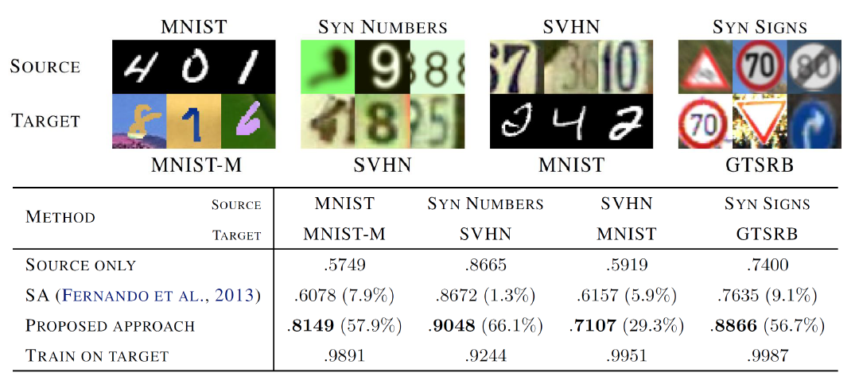
Introduction
Overview: Domain adversarial training
Yaroslav Ganin, Victor Lempitsky, Unsupervised Domain Adaptation by Backpropagation, ICML, 2015
Hana Ajakan, Pascal Germain, Hugo Larochelle, François Laviolette, Mario Marchand,
Domain-Adversarial Training of Neural Networks, JMLR, 2016
Lecture 14 -
9

Slide 10
Introduction
Overview:
 | Source Data (Not directly related to task)
Target Data |  | Labelled | Unlabeled
 | Labelled | Fine-tuning Multitask Learning
 | Unlabeled | Domain-adversarial training Zero-shot Learning
Lecture 14 -
10

Slide 11
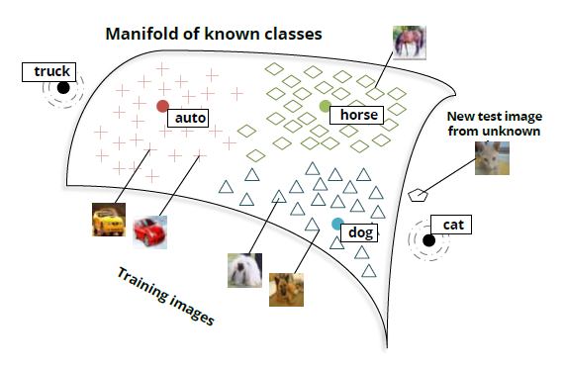
Introduction
Overview: Zero-shot Learning
Richard Socher, Milind Ganjoo, Christopher D. Manning, Andrew Y. Ng, “Zero-Shot Learning Through Cross-Modal Transfer” NIPS,2013
Lecture 14 -
11

Slide 12
Introduction
Overview:
 | Source Data (Not directly related to task)
Target Data |  | Labelled | Unlabeled
 | Labelled | Fine-tuning Multitask Learning | Self-taught learning
 | Unlabeled | Domain-adversarial training Zero-shot Learning
Lecture 14 -
12

Slide 13
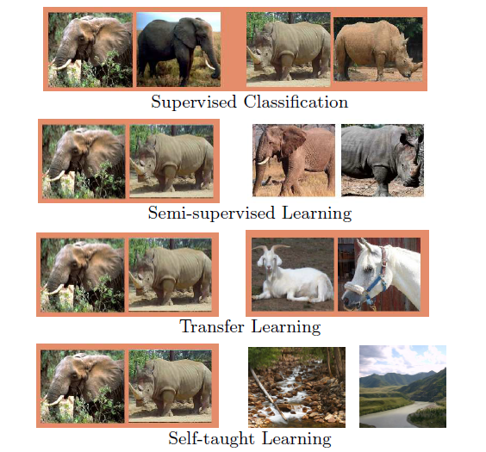
Introduction
Overview: Self-taught Learning
Rajat Raina, Alexis Battle, Honglak Lee, Benjamin Packer, Andrew Y. Ng,"Self-taught Learning: Transfer Learning from Unlabeled Data", ICML,2007
Lecture 14 -
13

Slide 14
Introduction
Overview:
 | Source Data (Not directly related to task)
Target Data |  | Labelled | Unlabeled
 | Labelled | Fine-tuning Multitask Learning | Self-taught learning
 | Unlabeled | Domain-adversarial training Zero-shot Learning | Self-taught clustering
Lecture 14 -
14

Slide 15
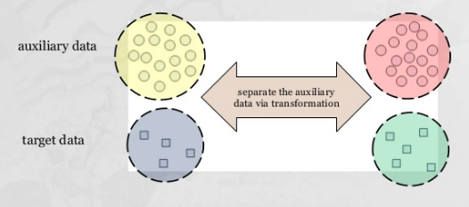
Introduction
Overview: Self-taught Clustering
Wenyuan Dai, Qiang Yang, Gui-Rong Xue, Yong Yu, “Self-taught Clustering ”, ICML,2008
Lecture 14 -
15

Slide 16
Introduction
Overview:
 | Source Data (Not directly related to task)
Target Data |  | Labelled | Unlabeled
 | Labelled | Fine-tuning Multitask Learning | Self-taught learning
 | Unlabeled | Domain-adversarial training Zero-shot Learning | Self-taught clustering
Lecture 14 -
16

Slide 17

Introduction
What is OCR
OCR (Optical Character Recognition )
is a general technique to extract handwritten texts or digitizing pictures
Lecture 14 -
17

Slide 18
Introduction
Two Types of OCR
Online text recognition:
words and characters are recognized at run time as quickly as they are
written, and consequently, have temporal information
Offline text recognition:
processes a static representation of an article. Recognition offline text is partitioned in two sub categories o
f Typed and Handwritten articles.
Lecture 14 -
18

Slide 19
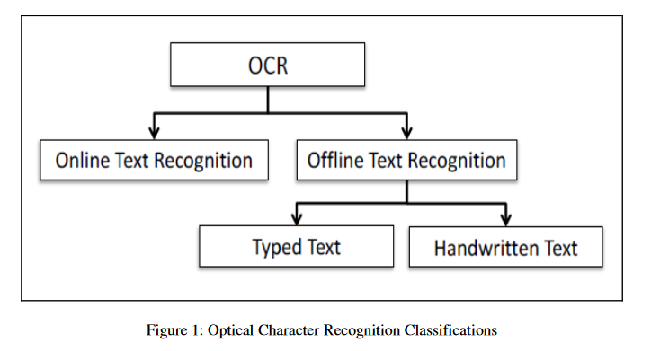
Introduction
In Summary
HCR
Lecture 14 -
19

Slide 20
Workflow
OCR consist of four major stages :
Pre-processing
Segmentation
Feature Extraction
Classification
Post-processing
Lecture 14 -
20

Slide 21
Pre-processing
Pre-processing aims to produce data that are easy for the OCR systems to operate accurately. The main objectives of pre-processing are :
Binarization
Noise reduction
Stroke width normalization
Skew correction
Slant removal

Slide 22
Binarization
Document image binarization (thresholding) refers to the conversion of a gray-scale image into a binary image. Two categories of thresholding:
Global, picks one threshold value for the entire document image which is often based on an estimation of the background level from the intensity histogram of the image.
Adaptive (local), uses different values for each pixel according to the local area information

Slide 23
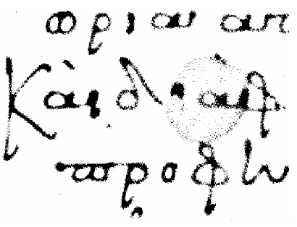
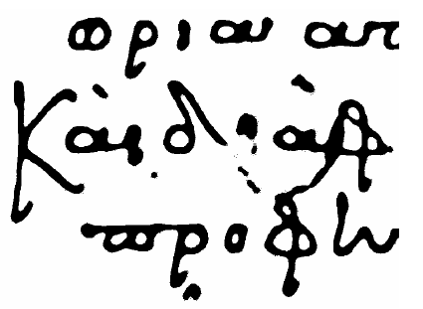
Noise Reduction - Normalization
Noise reduction improves the quality of the document. Two main approaches:
Filtering (masks)
Morphological Operations (erosion, dilation, etc)
Normalization provides a tremendous reduction in data size, thinning extracts the shape information of the characters.

Slide 24
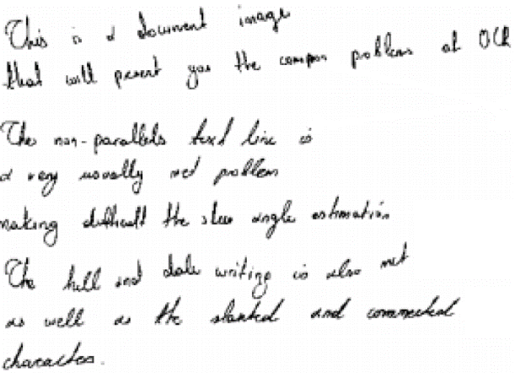
Skew Correction
Skew Correction methods are used to align the paper document with the coordinate system of the scanner. Main approaches for skew detection include correlation, projection profiles, Hough transform.

Slide 25





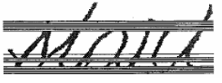
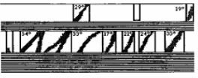
Slant Removal
The slant of handwritten texts varies from user to user. Slant removal methods are used to normalize the all characters to a standard form.
Popular deslanting techniques are:
Calculation of the average angle of near-vertical elements
Bozinovic – Shrihari Method (BSM).

Slide 26
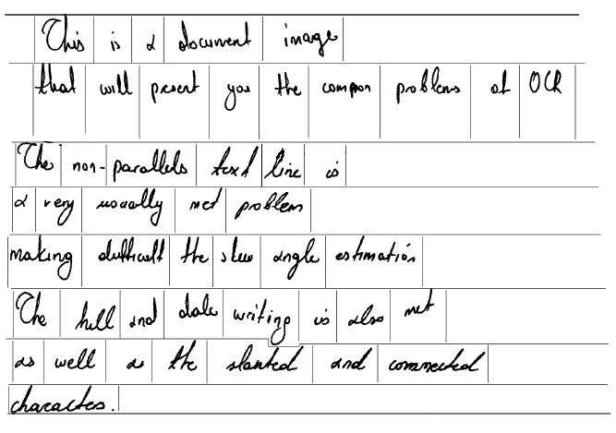
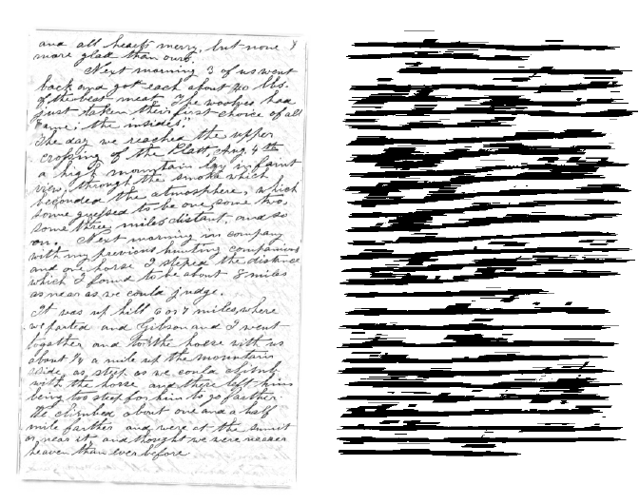

Segmentation
Text Line Detection (Hough Transform, projections, smearing)
Word Extraction (vertical projections, connected component analysis)
Word Extraction 2 (RLSA)

Slide 27

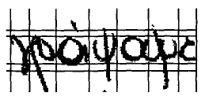
Segmentation
Explicit Segmentation
In explicit approaches one tries to identify the smallest possible word segments (primitive segments) that may be smaller than letters, but surely cannot be segmented further. Later in the recognition process these primitive segments are assembled into letters based on input from the character recognizer. The advantage of the first strategy is that it is robust and quite straightforward, but is not very flexible.
Implicit Segmentation
In implicit approaches the words are recognized entirely without segmenting them into letters. This is most effective and viable only when the set of possible words is small and known in advance, such as the recognition of bank checks and postal address

Slide 28
Feature Extraction
In feature extraction stage each character is represented as a feature vector, which becomes its identity. The major goal of feature extraction is to extract a set of features, which maximizes the recognition rate with the least amount of elements.
Due to the nature of handwriting with its high degree of variability and imprecision obtaining these features, is a difficult task. Feature extraction methods are based on 3 types of features:
Statistical
Structural
Global transformations and moments

Slide 29
Statistical Features
Representation of a character image by statistical distribution of points takes care of style variations to some extent.
The major statistical features used for character representation are:
Zoning
Projections and profiles
Crossings and distances

Slide 30


Zoning
The character image is divided into NxM zones. From each zone features are extracted to form the feature vector. The goal of zoning is to obtain the local characteristics instead of global characteristics

Slide 31

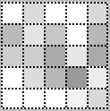
Zoning – Density Features
The number of foreground pixels, or the normalized number of foreground pixels, in each cell is considered a feature.
Darker squares indicate higher density of zone pixels.

Slide 32

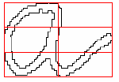
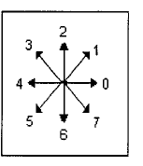
Zoning – Direction Features
Based on the contour of the character image
For each zone the contour is followed and a directional histogram is obtained by analyzing the adjacent pixels in a 3x3 neighborhood

Slide 33


Zoning – Direction Features
Line segments are coded with a direction number
2 = vertical line segment
3 = right diagonal line segment
4 = horizontal line segment
5 = left diagonal line segment
Based on the skeleton of the character image
Distinguish individual line segments
Labeling line segment information
Line type normalization
Formation of feature vector through zoning
number of horizontal lines | total length of horizontal lines | number of right diagonal lines | total length of right diagonal lines | number of vertical lines | total length of vertical lines | number of left diagonal lines | total length of left diagonal lines | number of intersection points

Slide 34
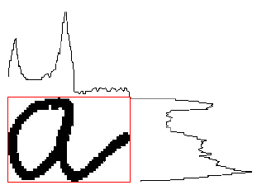
Projection Histograms
The basic idea behind using projections is that character images, which are 2-D signals, can be represented as 1-D signal. These features, although independent to noise and deformation, depend on rotation.
Projection histograms count the number of pixels in each column and row of a character image. Projection histograms can separate characters such as “m” and “n” .

Slide 35
Profiles
The profile counts the number of pixels (distance) between the bounding box of the character image and the edge of the character. The profiles describe well the external shapes of characters and allow to distinguish between a great number of letters, such as “p” and “q”.

Slide 36
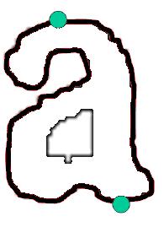
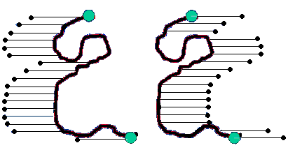
Profiles
Profiles can also be used to the c of the character image
Extract the contour of the character
Locate the uppermost and the lowermost points of the contour
Calculate the in and out profiles of the contour

Slide 37
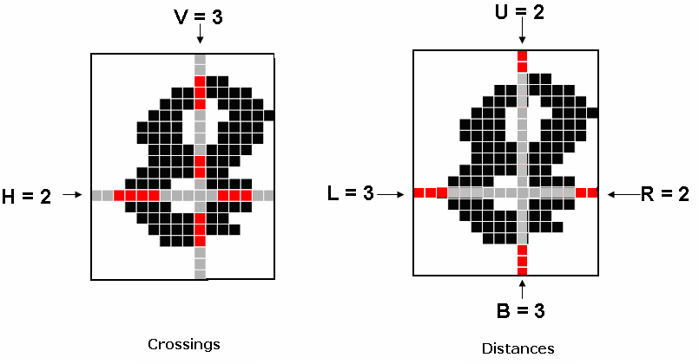
Crossings and Distances
Crossings count the number of transitions from background to foreground pixels along vertical and horizontal lines through the character image and
Distances calculate the distances of the first image pixel detected from the upper and lower boundaries, of the image, along vertical lines and from the left and right boundaries along horizontal lines

Slide 38
Structural Features
Characters can be represented by structural features with high tolerance to distortions and style variations. This type of representation may also encode some knowledge about the structure of the object or may provide some knowledge as to what sort of components make up that object.
Structural features are based on topological and geometrical properties of the character, such as aspect ratio, cross points, loops, branch points, strokes and their directions, inflection between two points, horizontal curves at top or bottom, etc.

Slide 39
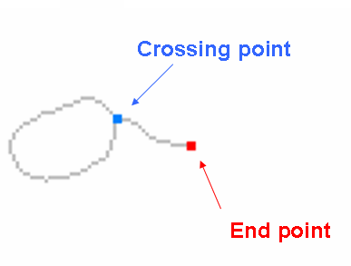
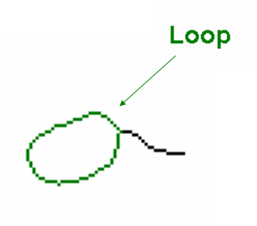
Structural Features

Slide 40
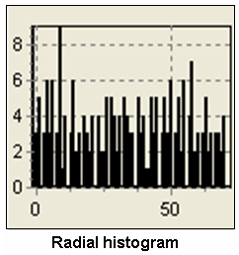
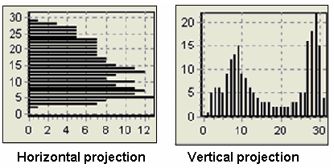
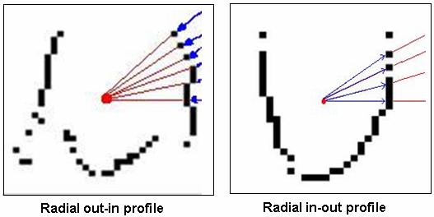
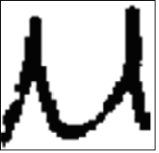
Structural Features
A structural feature extraction method for recognizing Greek handwritten characters [Kavallieratou et.al 2002]
Three types of features:
Horizontal and Vertical projection histograms
Radial histogram
Radial out-in and radial in-out profiles

Slide 41
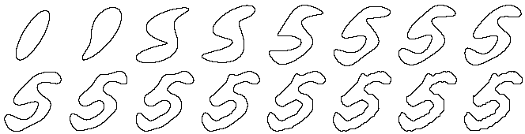
Global Transformations - Moments
The Fourier Transform (FT) of the contour of the image is calculated. Since the first n coefficients of the FT can be used in order to reconstruct the contour, then these n coefficients are considered to be a n-dimesional feature vector that represents the character.
Central, Zenrike moments that make the process of recognizing an object scale, translation, and rotation invariant. The original image can be completely reconstructed from the moment coefficients.

Slide 42
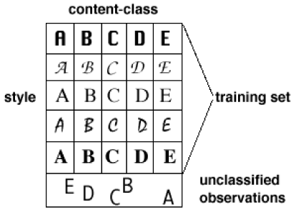
Classification
k-Nearest Neighbour (k-NN) , Bayes Classifier, Neural Networks (NN), Hidden Markov Models (HMM), Support Vector Machines (SVM), etc
There is no such thing as the “best classifier”. The use of classifier depends on many factors, such as available training set, number of free parameters etc.

Slide 43
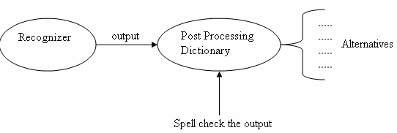
Post-processing
Goal : the incorporation of context and shape information in all the stages of OCR systems is necessary for meaningful improvements in recognition rates.
The simplest way of incorporating the context information is the utilization of a dictionary for correcting the minor mistakes.
In addition to the use of a dictionary, a well-developed lexicon and a set of orthographic rules (lexicon-driven matching approaches) during or after the recognition stage for verification and improvement purpose.

Slide 44
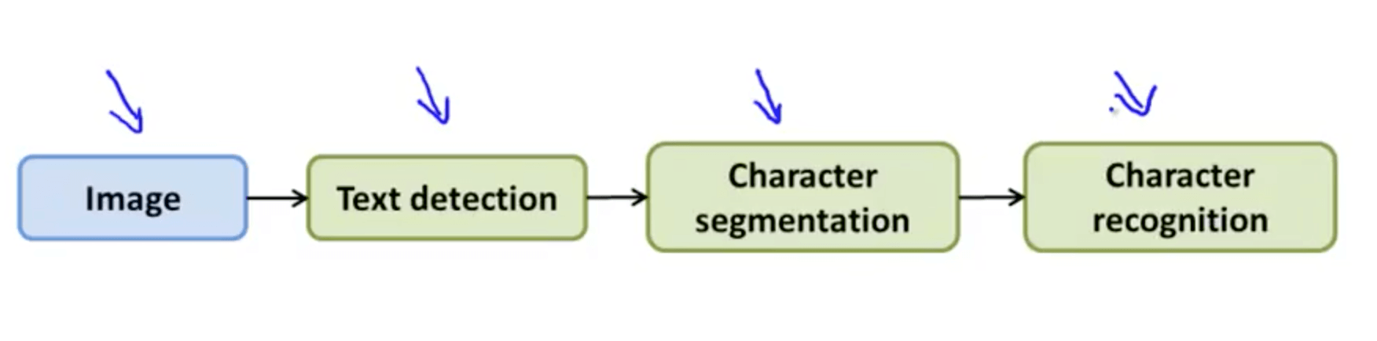
OCR using Deep Learning
OCR Pipeline
Text detection
Character segmentation
Character classification
Lecture 14 -
44

Slide 45
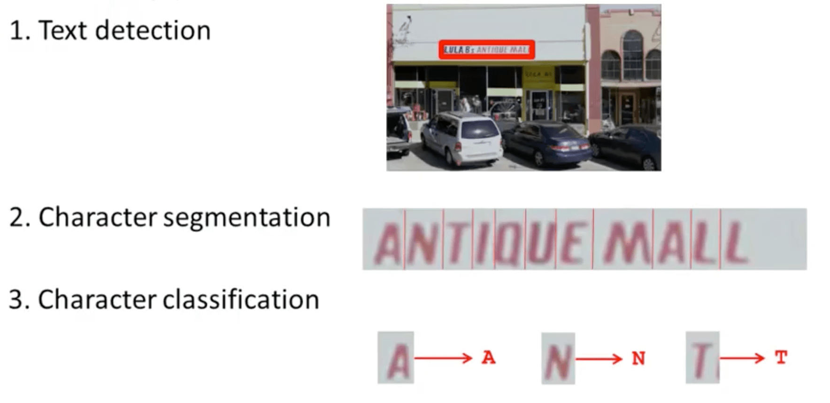
OCR using Deep Learning
OCR Pipeline
Lecture 14 -
45

Slide 46
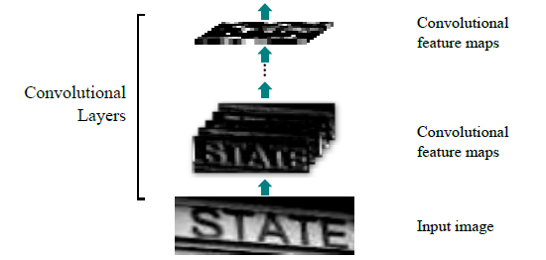
OCR using Deep Learning
CNN-LSTM Architecture-Convolutional Layer
Lecture 14 -
46

Slide 47
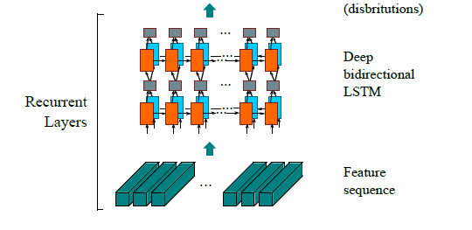
OCR using Deep Learning
CNN-LSTM Architecture-Recurrent layer
Lecture 14 -
47

Slide 48
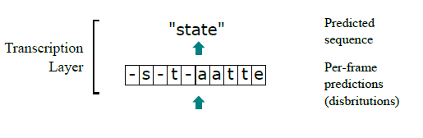
OCR using Deep Learning
CNN-LSTM Architecture-Transcription layer
Lecture 14 -
48

Slide 49
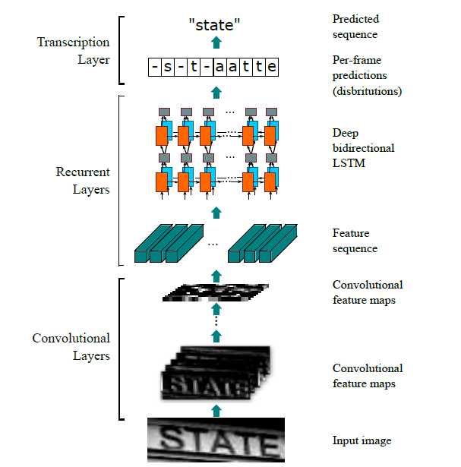
OCR using Deep Learning
CNN-LSTM Architecture
Transcription layer, which
translates the per-frame predictions into the final label sequence
Recurrent layers, which predict
a label distribution for each frame
Convolutional layers, which extract a feature sequence
from the input image
Lecture 14 -
49

Slide 50
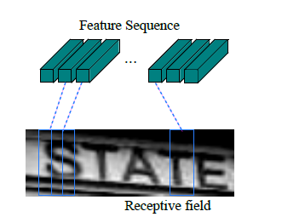
OCR using Deep Learning
CNN-LSTM Architecture-Feature sequence
The receptive field.
Each vector in the extracted feature sequence is associated with a receptive field on the input image
Vector can be considered as the feature vector of that field.
Lecture 14 -
50

Slide 51
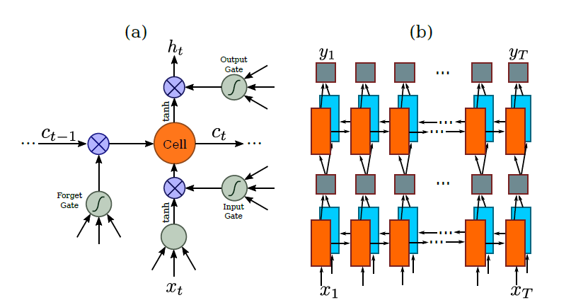
OCR using Deep Learning
CNN-LSTM Architecture-LSTM Unit
3 Gates
Left to Right
Right to Left
Lecture 14 -
51

Slide 52
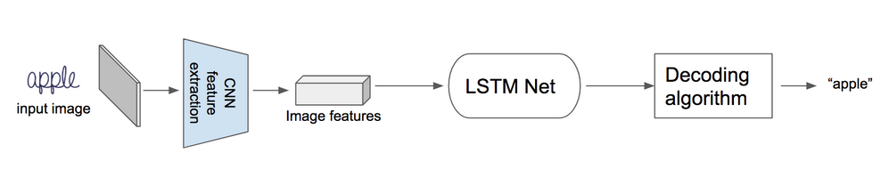
OCR using Deep Learning
CNN-LSTM Architecture
A small demo for explanation
Lecture 14 -
52

Slide 53
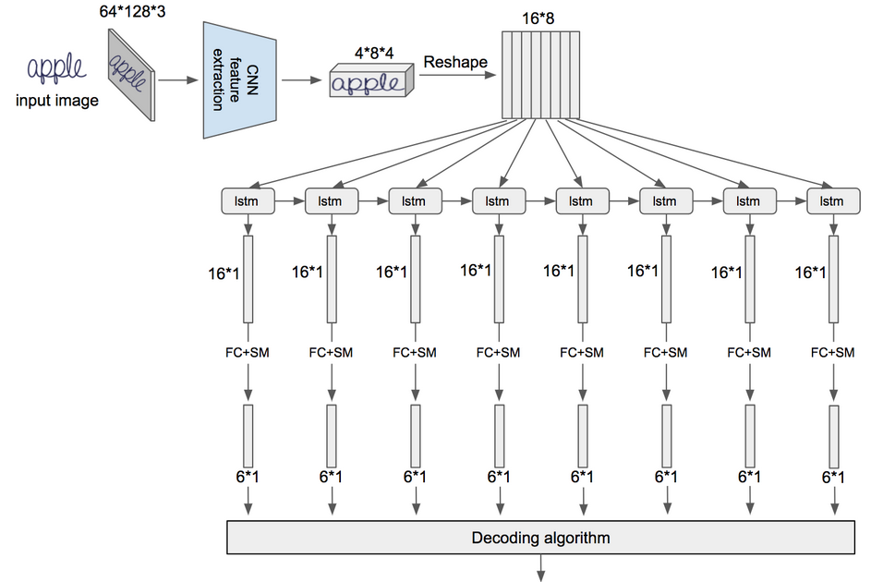
OCR using Deep Learning
1 Step: Image is feed to CNN to extract image features
FC -fully connected layer,
SM- softmax layer.
Lecture 14 -
53

Slide 54
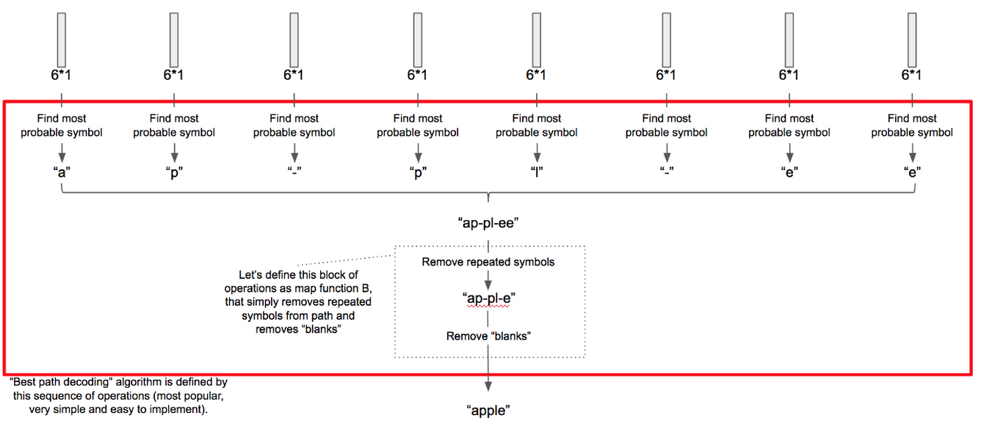
OCR using Deep Learning
CNN-LSTM Architecture
2 Step: Apply Recurrent Neural Network to these features followed by decoding algorithm
Lecture 14 -
54

Slide 55
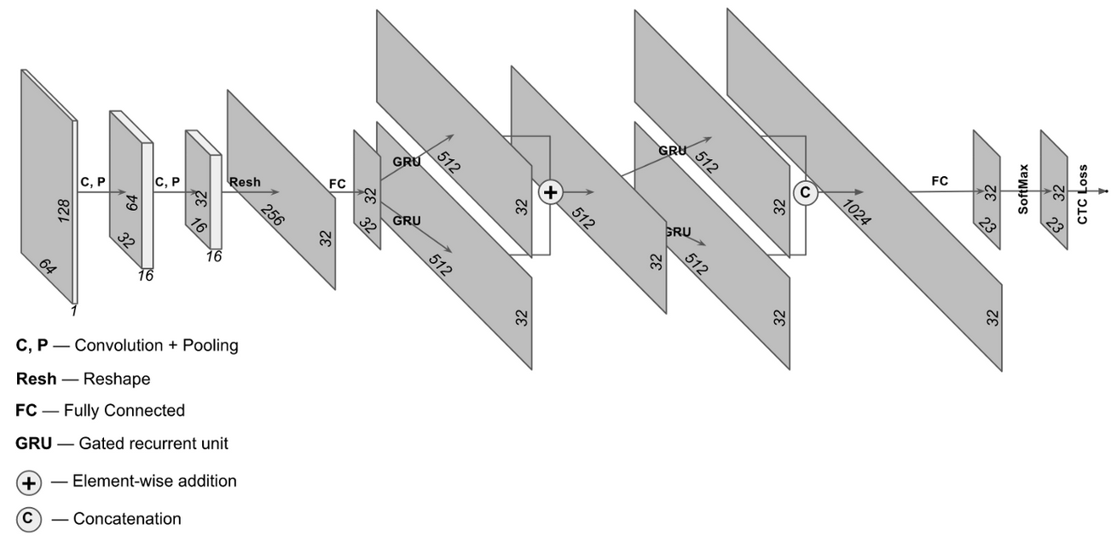
OCR using Deep Learning
CNN-LSTM Architecture
Lecture 14 -
55

Slide 56
OCR using Deep Learning
Comparative Evaluation – Public datasets
IC03: test dataset contains 251 scene images with labeled text bounding boxes.
IC13: test dataset inherits most of its data from IC03. It contains 1,015 ground truths cropped word images.
IIIT5k: contains 3,000 cropped word test images collected from the Internet. Each image has been associated to a 50-words lexicon and a 1k-words lexicon.
SVT: test dataset consists of 249 street view images collected from Google Street View. From them 647 word images are cropped. Each word image has a 50 words lexicon defined by Wang et al.
Lecture 14 -
56

Slide 57
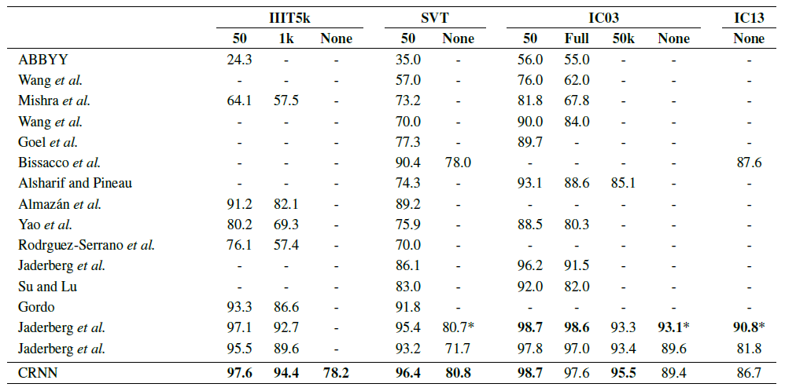
OCR using Deep Learning
Recognition accuracies (%) on four datasets
“50”, “1k”, “50k” and “Full” denote the lexicon
“None” denotes recognition without a lexicon
* is not lexicon-free in the strict sense
Comparative Evaluation – Result
Lecture 14 -
57

Slide 58
OCR using Deep Learning
Popular OCR Engines:
tesseract - The definitive Open Source OCR engine Apache 2.0
ocropus - OCR engine based on LSTM, Apache 2.0
ocropus 0.4 - Older v0.4 state of Ocropus, with tesseract 2.04 and iulib, C++
kraken - Ocropus fork with sane defaults
Ocrad - The GNU OCR. GPL
digit - OCR for numbers in meter displays, such as a power meter, using caffe
ocular - Machine-learning OCR for historic documents
SwiftOCR - fast and simple OCR library written in Swift
attention-ocr - OCR engine using visual attention mechanisms
RWTH-OCR - The RWTH Aachen University Optical Character Recognition System
simple-ocr-opencv and its fork - A simple pythonic OCR engine using opencv and numpy
Comparison of optical character recognition software
14 -
58

Slide 59
OCR using Deep Learning
Brief introduction of Tesseract Engine
Sourced by HP since 1985
Developed by Google. Since 2006
Open source text recognizer (OCR) Engine
under the Apache 2.0 license.
~100 Languages available
Lecture 14 -
59

Slide 60
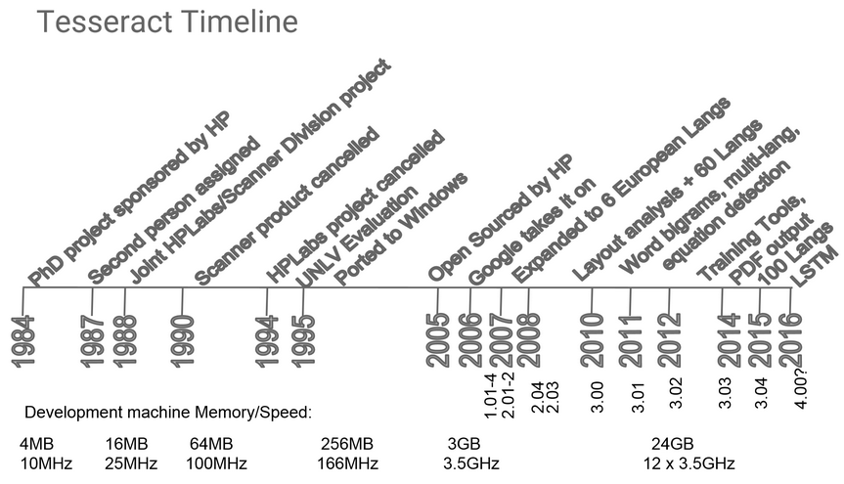
OCR using Deep Learning
Tesseract Engine History:
Lecture 14 -
60

Slide 61
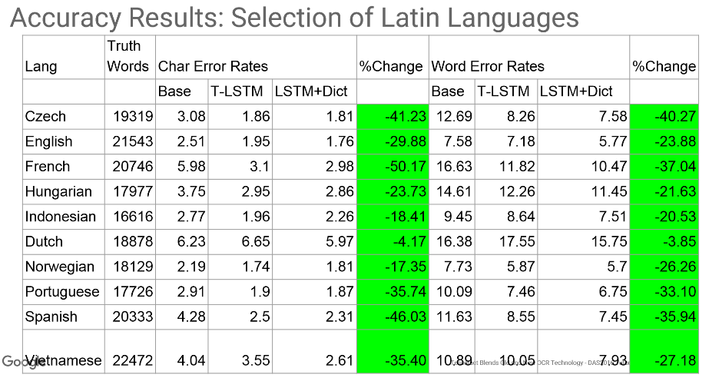
OCR using Deep Learning
Compare to 1995 result
Tesseract Performance
Lecture 14 -
61

Slide 62
OCR using Deep Learning
Conclusion:
Better accuracy
Less feature designing needed in Deep learning
Robust and data driven
Trainable for multi-language available
Tesseract are surprisingly general
~100 Languages available
Lecture 14 -
62

Slide 63
References
[1] Alex Graves, Santiago Fernndez, Faustino Gomez Jrgen Schmidhuber, Connectionist temporal classification: labelling unsegmented sequence data with recurrent neural networks, Proceedings of the 23rd international conference on Machine learning. 2006
[2] Convolutional Neural Network Benchmarks: https://github.com/jcjohnson/cnn-benchmarks
[3] Elie Krevat, Elliot Cuzzillo. Improving Off-line Handwritten Character Recognition with Hidden Markov Models.
[4] Fabian Tschopp. Efficient Convolutional Neural Networks for Pixelwise Classification on Heterogeneous Hardware Systems
[5] George Nagy. Document processing applications.
[6] Mail encoding and processing system patent: https://www.google.com/patents/US5420403
[7] Kurzweil Computer Products. http://www.kurzweiltech.com/kcp.html
[8] H. Bunke1, M. Roth1, E.G. Schukat-Talamazzini. Offline Cursive Handwriting Recognition using Hidden Markov Models.
Lecture 14 -
63

